Slide 1
Navigating the Future of Online Shopping
E-Commerce Data Analysis
A Comparative Approach using SQL and Python

Slide 2
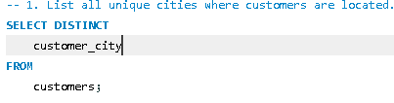
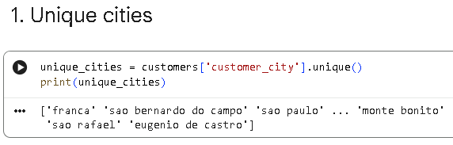
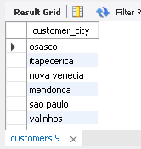
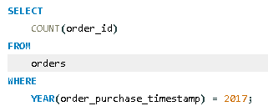
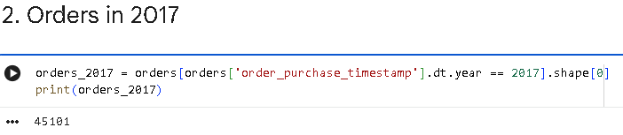

BASIC PROBLEMS
OBJECTIVE: EXTRACT FUNDAMENTAL INSIGHTS FROM THE DATASET
LIST ALL UNIQUE CITIES WHERE CUSTOMERS ARE LOCATED
SQL QUERY PYTHON CODE
Count the number of orders placed in 2017
SQL QUERY PYTHON CODE

Slide 3
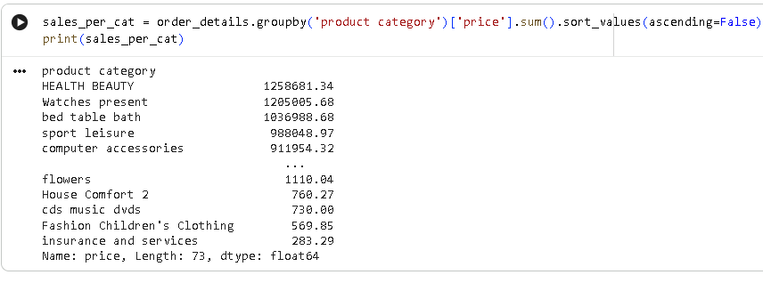
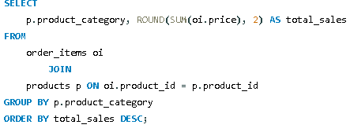
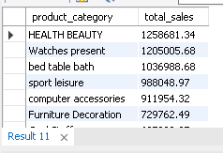
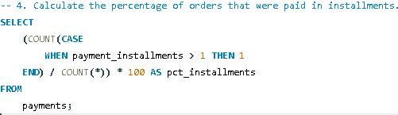
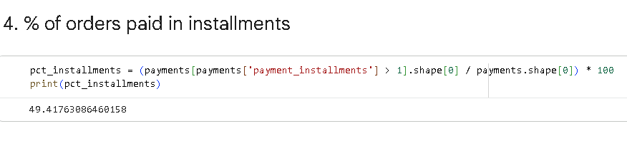

Find the total sales per category sQL query python code
. CALCULATE THE PERCENTAGE OF ORDERS THAT WERE PAID IN INSTALLMENTS

Slide 4
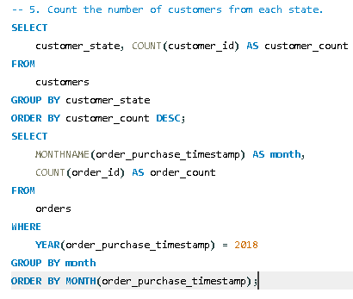
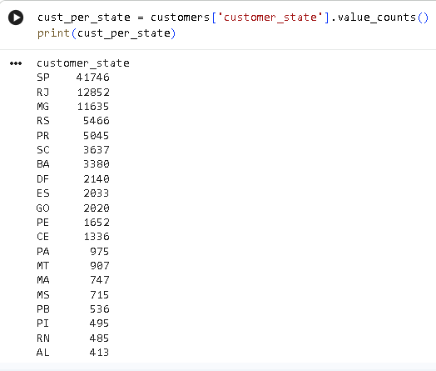
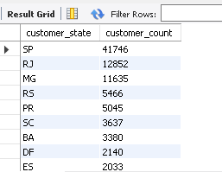
COUNT THE NUMBER OF CUSTOMERS FROM EACH STATE
SQL QUERY PYTHON CODE

Slide 5
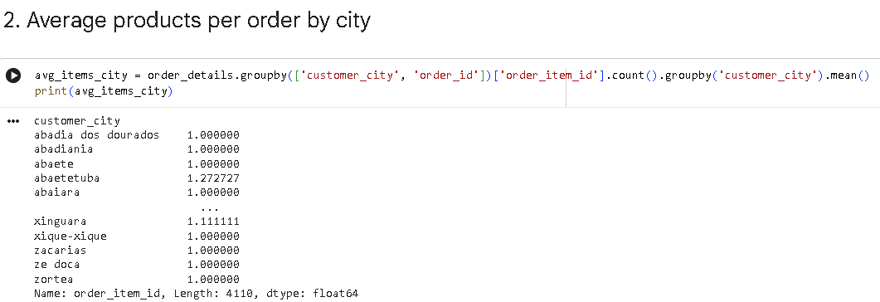
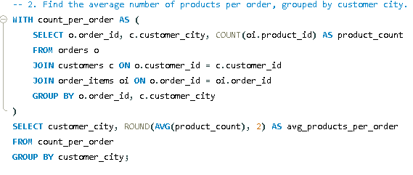
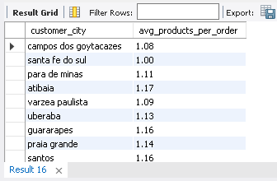
INTERMEDIATE PROBLEMS
Objective: Dive deeper into sales and order trends
Find the average number of products per order, grouped by customer city

Slide 6
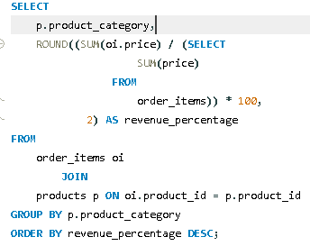
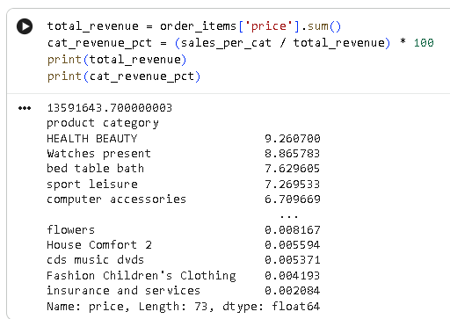
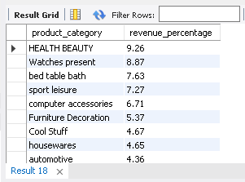
Calculate the percentage of total revenue contributed by each product category.

Slide 7
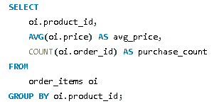
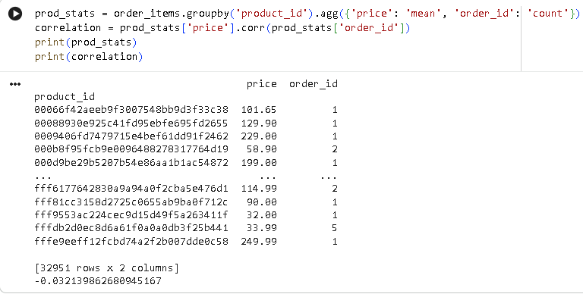
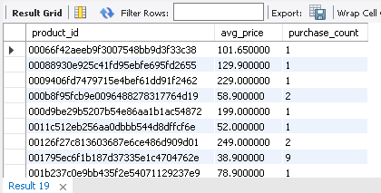
Identify the correlation between product price and the number of times a product has been purchased

Slide 8
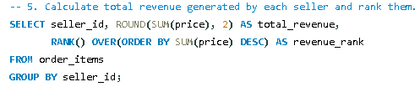
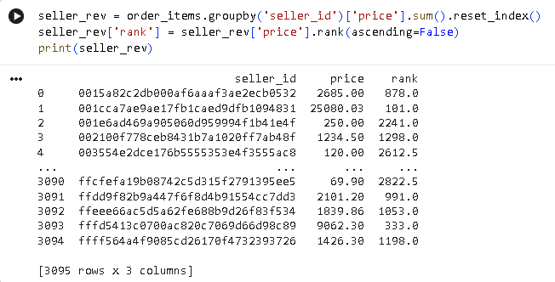
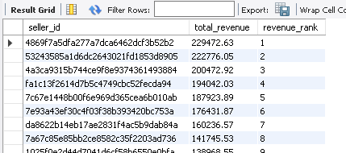
. Calculate the total revenue generated by each seller, and rank them by revenue.

Slide 9
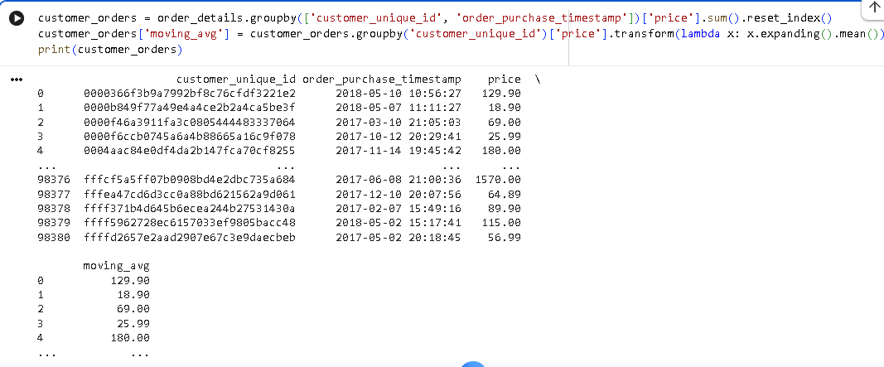
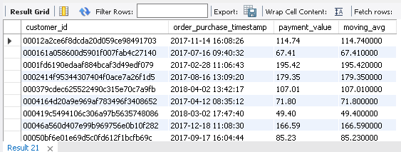
ADVANCED PROBLEMS
Objective: Generate strategic and customer-centric insights
. Calculate the moving average of order values for each customer over their order history.

Slide 10
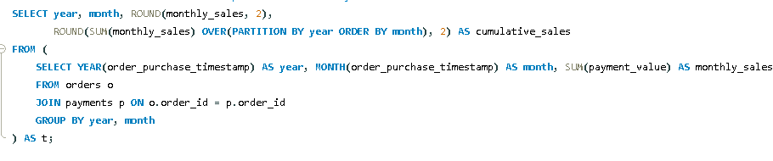
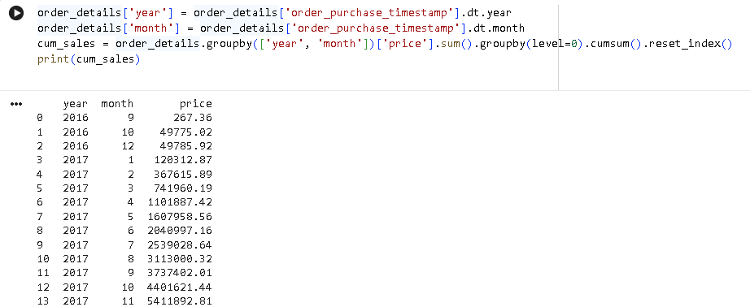
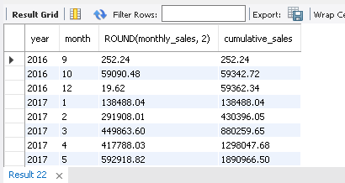
. Calculate the cumulative sales per month for each year

Slide 11
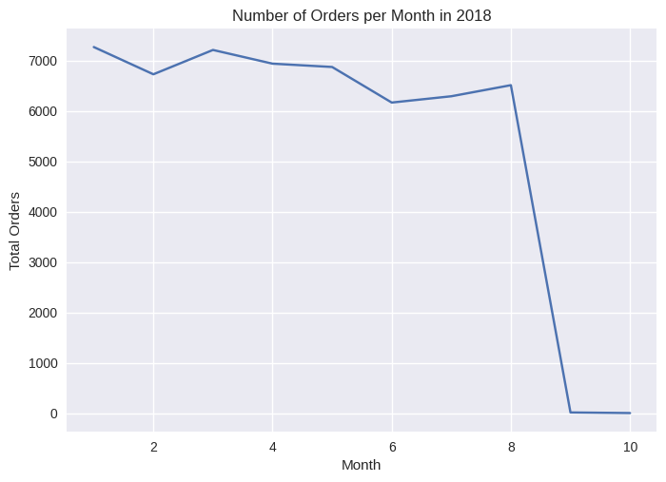
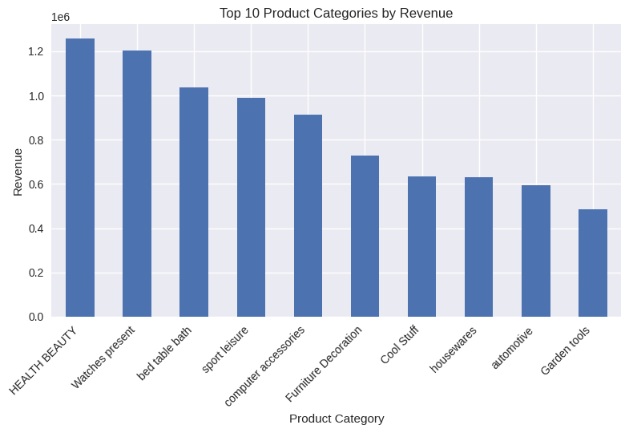
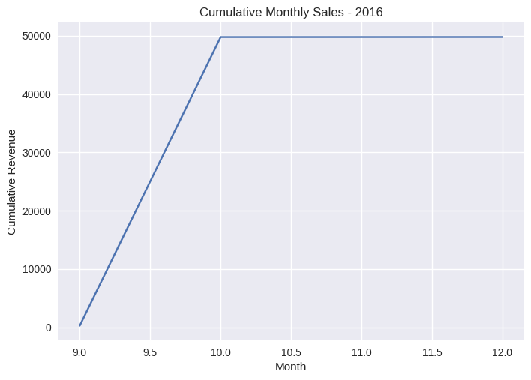
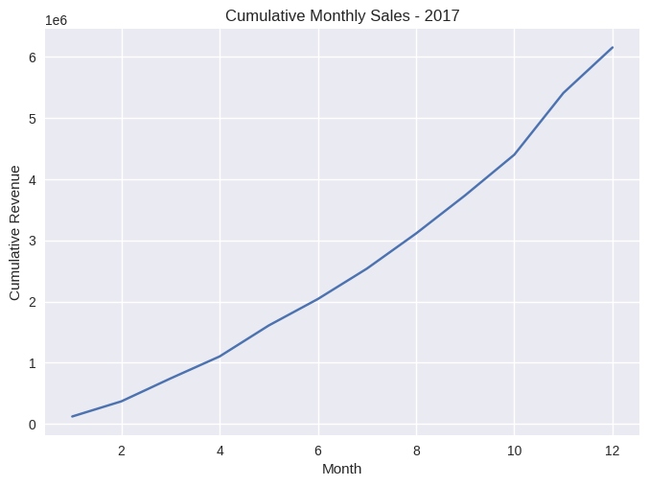
visualisations

Slide 12
